Slide 1

EVOLVE-X Review-1
IEEE Computer Society Hyderabad Section Chapter
Title: AUTOMATED CONTROL OF GREEN-HOUSE
Team Name: INFERNO
S. No | Name | College | Contact
1. | VIGNESH ROSHAN M | BANNARI AMMAN INSTITUTE OF TECHNOLOGY | 6382096401
2. | SUGIRDAN V | BANNARI AMMAN INSTITUTE OF TECHNOLOGY | 8903908986
3. | NITHISH SRIMAN K P | BANNARI AMMAN INSTITUTE OF TECHNOLOGY | 8903526189
4. | SRINIVASH V | BANNARI AMMAN INSTITUTE OF TECHNOLOGY | 9655148683

Slide 2
Main idea of the Project
With the development of agriculture technology, the greenhouse system plays a profound role in environmental modification allowing the growth of plants in different climatic conditions. In the present scenario, greenhouses generally make use of artificial means to monitor environmental factors. However, these techniques cause wastage of manpower and give inaccurate information regarding the environment. So, we have come up with a dynamic monitoring system for the greenhouse environment based on IoT. The proposed idea monitors factors like temperature, humidity, soil moisture, and light intensity. All these parameters are accessed by a user on a mobile app consisting of both manual and an automatic mode, via the cloud. Using the manual mode the user can alter the parameter thresholds and at the same time can also set values for the automatic mode. Hence, water pumps, heaters, coolers, and light sources are controlled to stabilize the greenhouse environment through greenhouse sensors and developed mobile applications.

Slide 3
Proposed Project Objectives
When it comes to Greenhouses, they are great protection from adverse weather conditions. Farm managers/farmers will be able to manage their Greenhouses more efficiently and handle their tasks more easily. The development of mobile application and inclusion of cloud in the whole setup makes data accessible and also ensures system monitoring from anywhere and anytime. At the same time, the user can customize the threshold of the parameters of the greenhouse environment in the manual and automatic mode of the mobile application as per the requirement in any situation.
1.IoT to observe from anywhere and anytime.
2.No need to go to the frequently, hence less man power.
3.Revenue of product perfectly satisfies the need of customers.
4.Accurate values in automatic method.
5.Automatic Water supply and temperature control.
6.Greatly reduce or eliminate labor and potential for human error in mixing feed formulas.

Slide 4
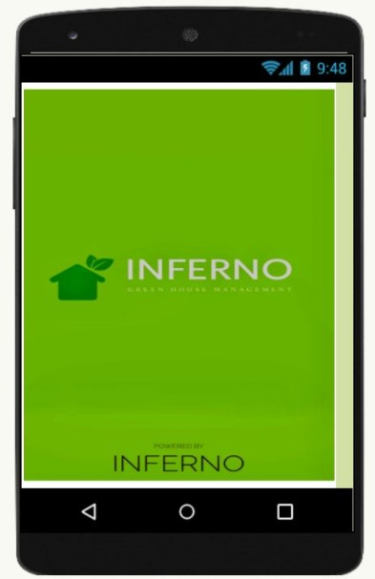
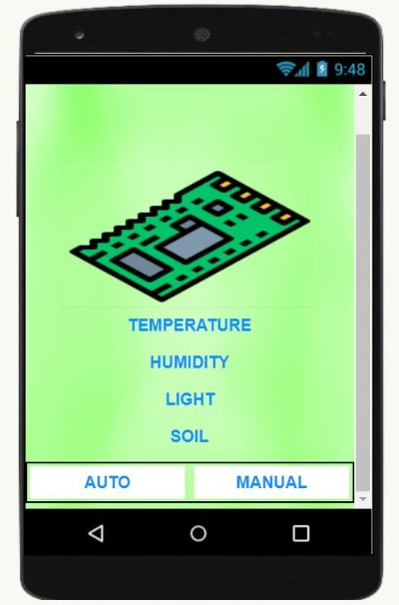
Proposed Project Outcomes

Slide 5
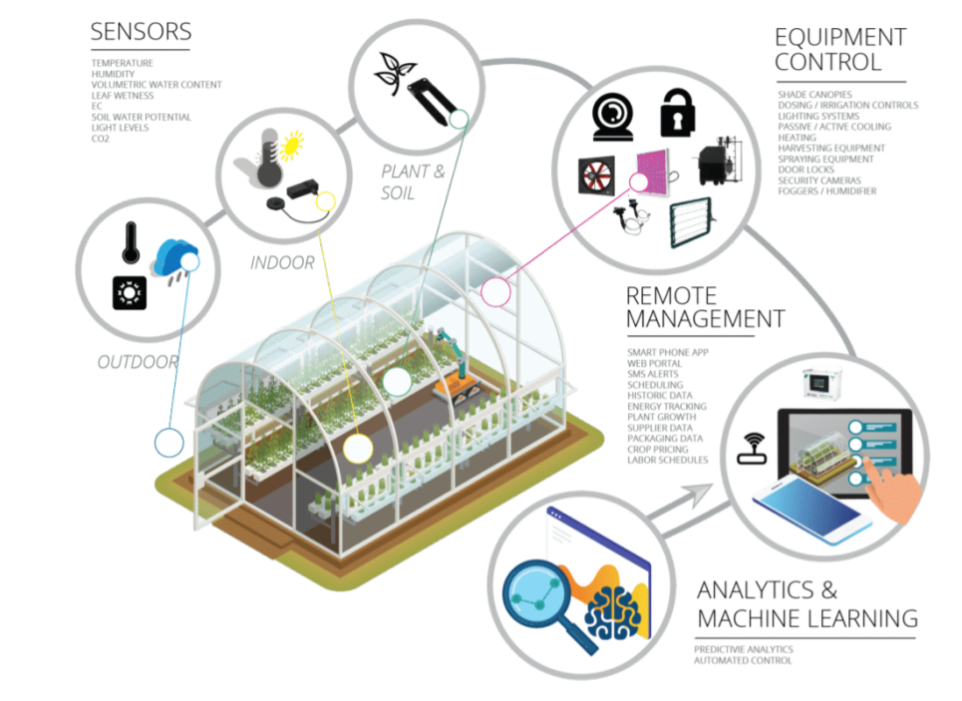
Process Model

Slide 6
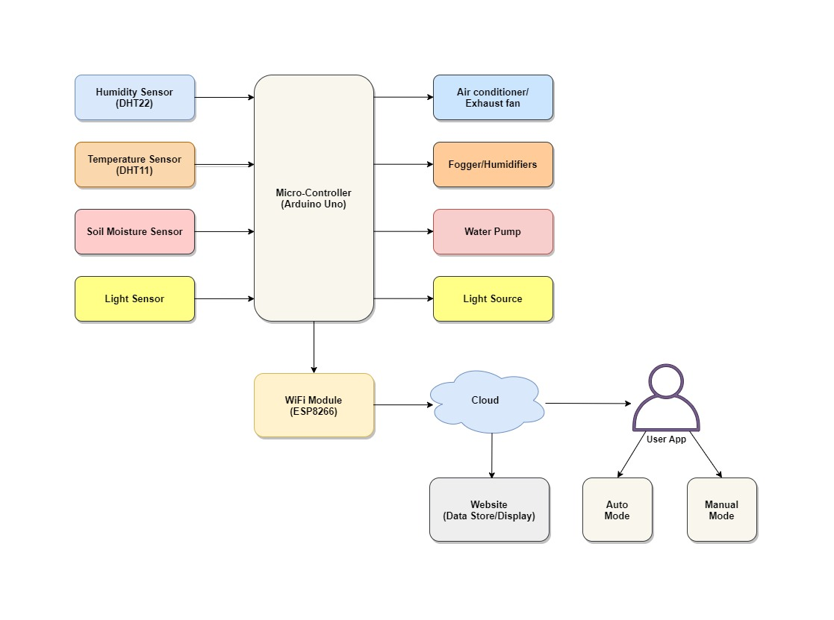
Architectural Diagram

Slide 7
Software and Hardware Requirements
Software Requirement:
1. Arduino IDE Software
2. Cloud Platform - Thing Speak
3. App Development - MIT App Inventor, MQTT Dashboard
Hardware Requirement:
1. Arduino IDE
2. DHT11: Temperature and Humidity Sensor
3. Soil Moisture Sensor
4. Light Sensor
5. Fan/Air Conditioner
6. Infrared Lights Required
7. Node MCU ESP8266
8. Humidifiers
9. Wires/Cables Required

Slide 8
Thank you

